Slide 1
Quantum Computing Shor`s algorithm and its application
Babushkin Igor
22132

Slide 2
Outline
01
02
03
04
Introduction
Shor`s algorithm
Basics of quantum computing
Operating principle of algorithm and its applications
Importance
Conclusion
Why is it so important?
Impact of Shor’s algorithm on cryptography

Slide 3
01
Introduction
3
7
5
0
9
Basics of quantum computing

Slide 4
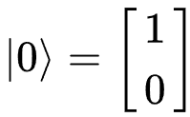
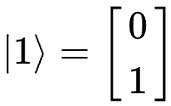
What is qubit?
5
6
7
Qubit is a unit of information. And a qubit represents zero and one, but also a superposition of these states.
0
0
1
0
Qubit
1
Qubit
8

Slide 5
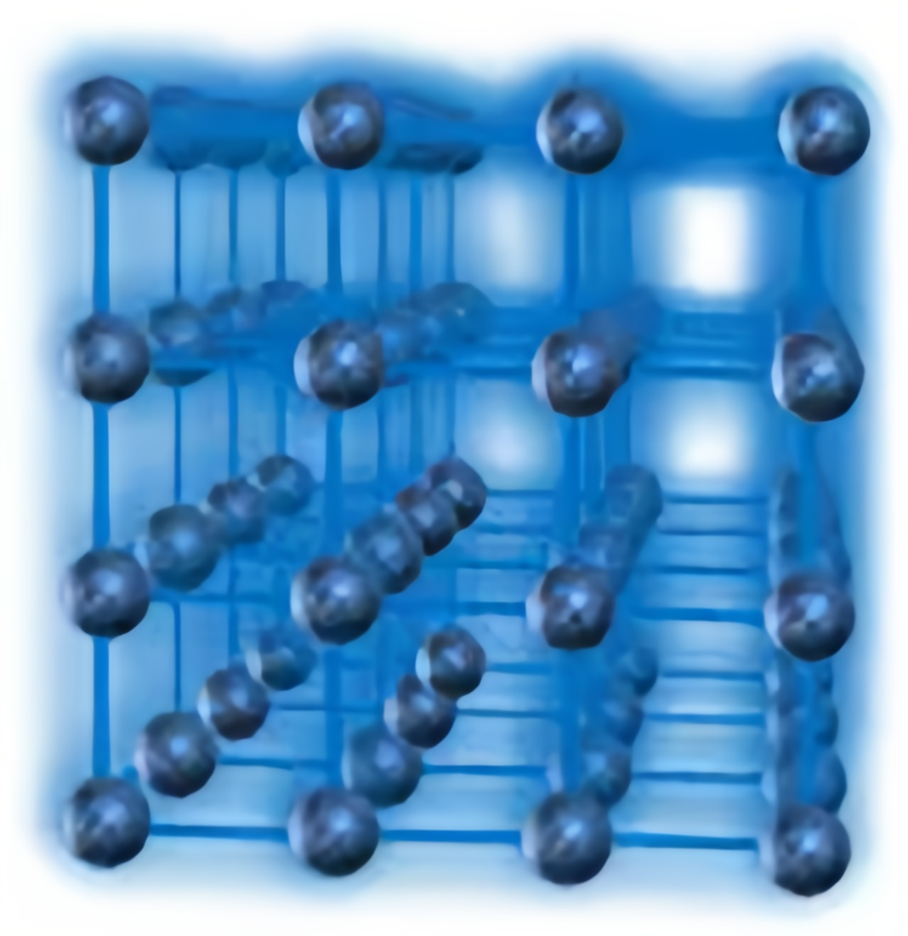

What are quantum entanglement and interference?
Quantum entanglement occurs when two or more qubits become interdependent.
Interference is a phenomenon that occurs when qubits interact with each other, which
leads to a change in their general state.

Slide 6
02
Shor`s algorithm
3
5
7
0
9
Operating principle of algorithm and its applications

Slide 7
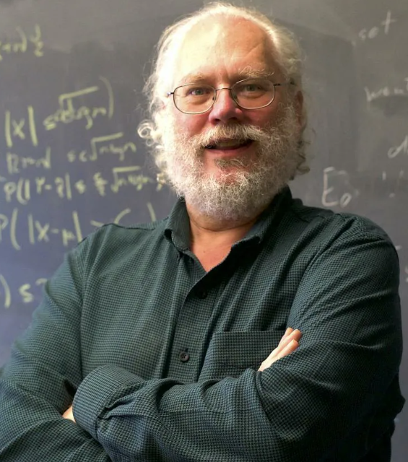
Peter Shor
Peter Shor, an American professor of applied mathematics in MIT, developed his algorithm in 1994.

Slide 8
Shor`s algorithm
21
Entanglement
Interference
2, 3, 5, 7
3, 7 will have a better chance
2, 5 will have a lower chance

Slide 9
Classical part of Shor`s algorithm
Let N be the number we want to factorize and a – random parameter
$$f\left(x\right)=a^{x}\operatorname{mod}{N}$$
If we find the period of this function, we can calculate all prime numbers of N

Slide 10
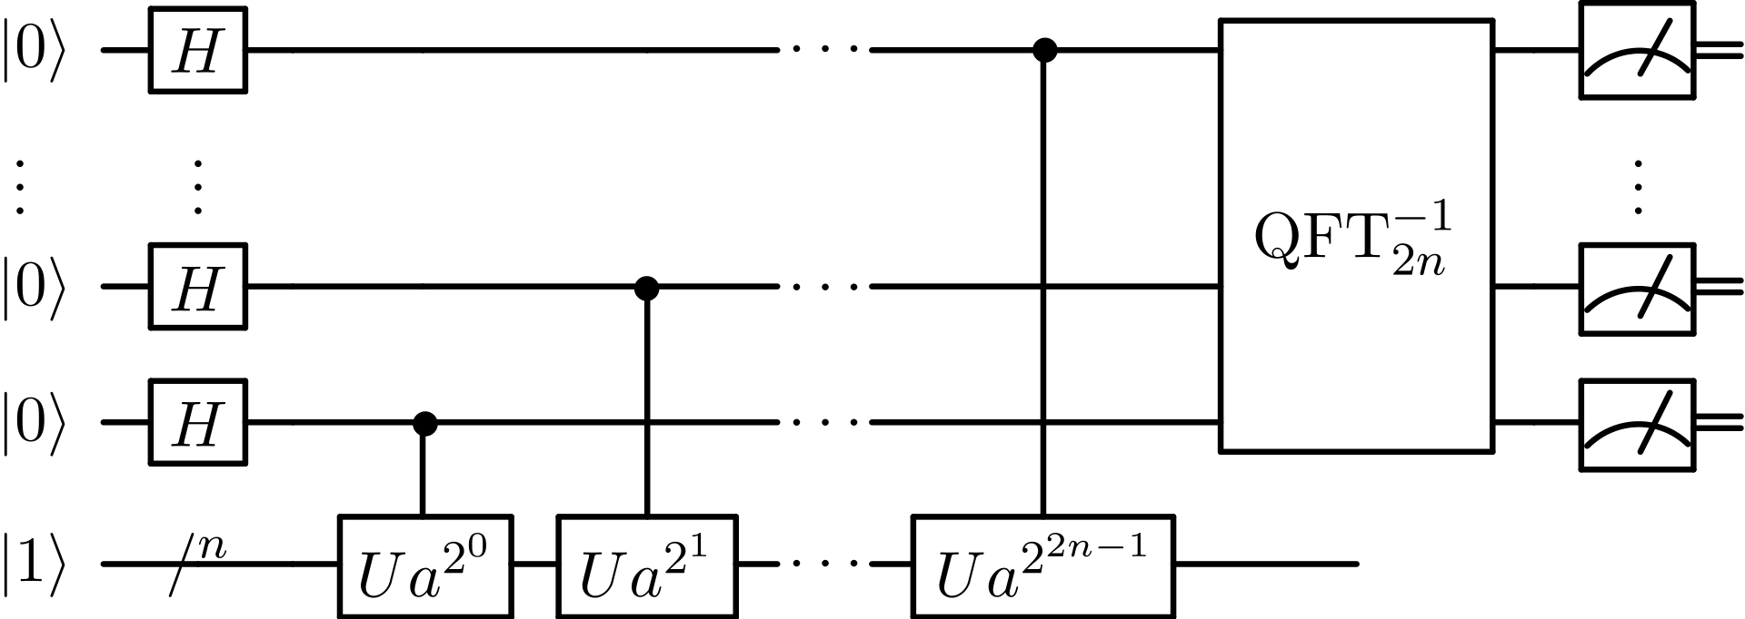
Quantum part of Shor`s algorithm

Slide 11
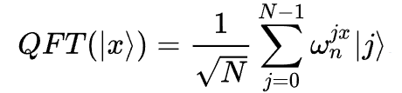
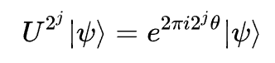
Quantum part of Shor`s algorithm

Slide 12
03
Importance
3
7
5
0
9
Why is it so important?

Slide 13
Cryptosystem
Encryption algorithm
Digital
signatures
Keys
Cryptosystem
Cryptographic hash-functions
Public Key Infrastructure
Protocols

Slide 14
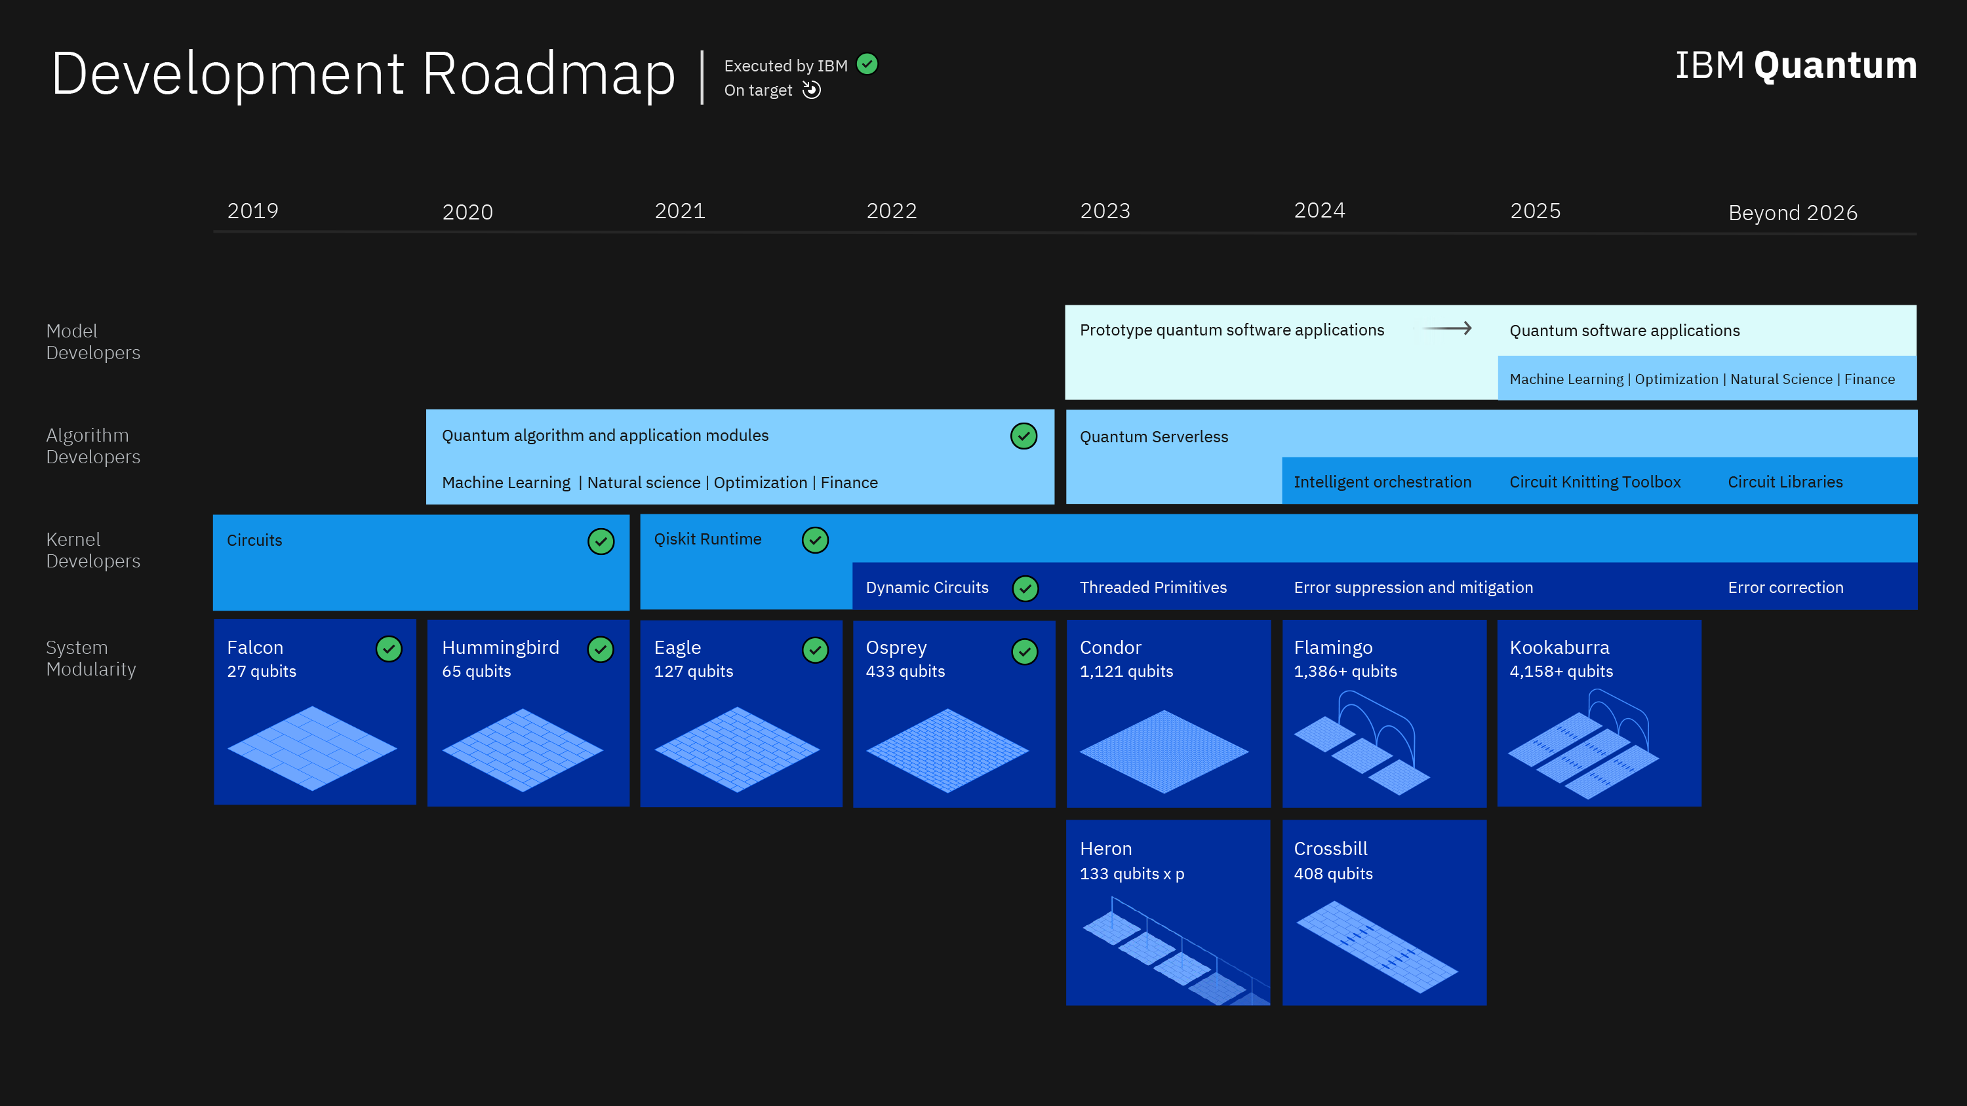
Importance

Slide 15
04
Conclusion
3
5
7
0
9
Impact of Shor’s algorithm on cryptography

Slide 16
Impact of Shor’s algorithm on cryptography
The Shor's algorithm holds great significance for cryptography.
This emphasizes the need for developing new encryption methods that are resistant to quantum computing.
Such methods are necessary to protect our information from potential threats.
Research in the field of post-quantum cryptography, for example, the development of algorithms based on other mathematical protocols, is the most relevant in this area.

Slide 17
References
Shor P. W. ”Algorithms for quantum computation: discrete logarithms and factoring. Foundations of Computer Science : Conference Publications.” — 1994
Flarend A., Hilborn B. “RSA Encryption and the Shor Factoring Algorithm” – April 2022
Norkin V. , Kozyriev A. “On Shor's r-Algorithm for Problems with Constraints” -- 6 November, 2023; originally announced October 2023.

Slide 18

Thank you for your attention!
My RnD-project about quantum computing:
https://github.com/RPogodin/ck-quantum

